Slide 1
COMP 3069 Computer Graphics
Lecture 8:
Texture II
Autumn 2018

Slide 2
Today’s Topics
Recap of last week
Texture mapping II
Texture animation
Spritesheet animation

Slide 3

Recap: Texturing a Cube
glEnable(GL_TEXTURE_2D);
glEnable(GL_COLOR_MATERIAL);
glBindTexture(GL_TEXTURE_2D, texId);
glBegin(GL_QUADS);
glTexCoord2f(0.0f, 1.0f);
glVertex3f(-0.5f, 0.5f, 0.5f);
glTexCoord2f(0.0f, 0.0f);
glVertex3f(-0.5f,-0.5f, 0.5f);
glTexCoord2f(1.0f, 0.0f);
glVertex3f( 0.5f,-0.5f, 0.5f);
glTexCoord2f(1.0f, 1.0f);
glVertex3f( 0.5f, 0.5f, 0.5f);
glEnd()
Assign texture coordinates to vertices

Slide 4
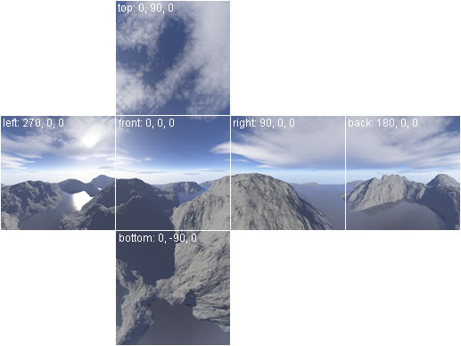
SkyBox
6 textures, often a combination
of the sky and terrains wrapping
the scene in it (lab tutorial)
Invert normal vectors of each
face so that we can see the
Inside of the cube

Slide 5
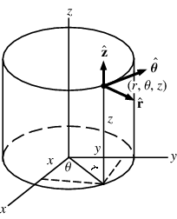
Cylindrical Coordinates
In cylindrical coordinate system, a point on the cylinder is represented by (r, θ, z ).
The radius r is constant on the cylinder, so can be ignored.
So each point on cylinder can be represented by (θ , z), which can be given a texture coordinate (s, t) as, e.g.,

Slide 6
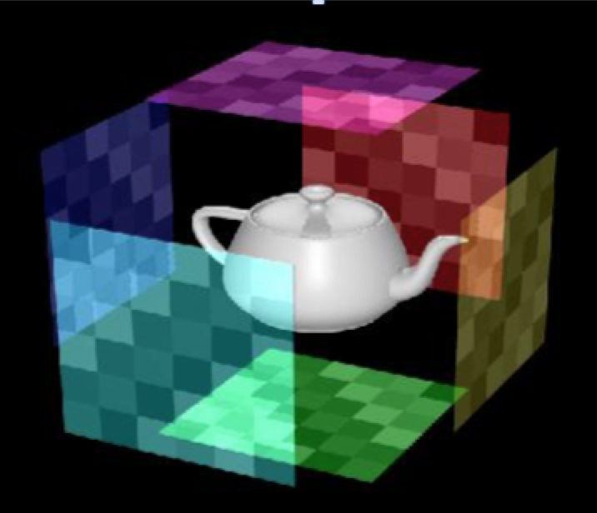
Texture Mapping II
Texture mapping using a map shape
Texture animation
Spritesheet animation

Slide 7
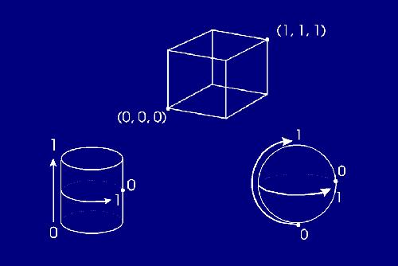
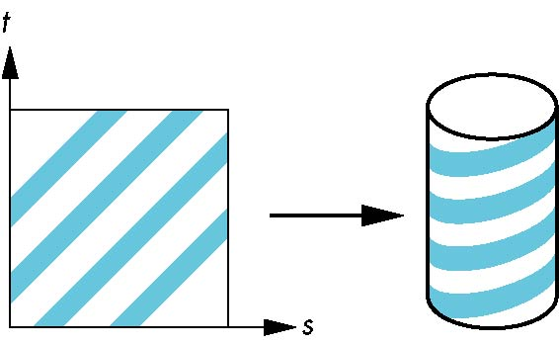
Texture Mapping of Complex Objects – Using a Map Shape
We can use a map shape to first map the texture to an intermediate surface, e.g., a cylinder or a sphere, with the object sitting in it, then project the texture onto the object
The map shape (box or cylinder, or sphere) can be represented by two parameters (like the texture)

Slide 8
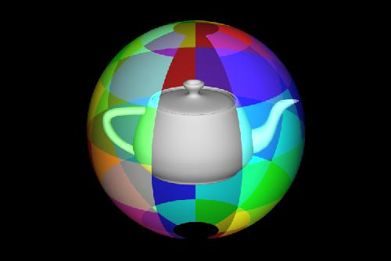
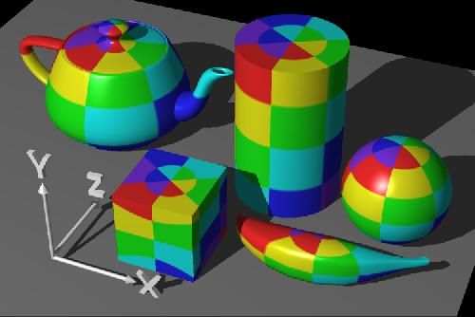
Using a Sphere Map Shape
Shoot a ray from the centre of the sphere which intersects both the cattle and the sphere
The intersection point on the cattle will be assigned the same texture as that of the sphere

Slide 9
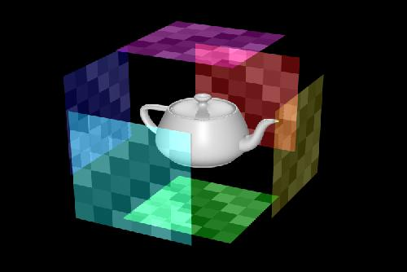
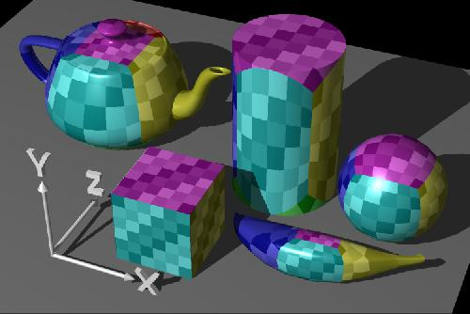
Using a Box Map Shape
This uses six texture maps - one each for the left, right, front, back, top and bottom sides of the object, e.g., to texture map the front side of the object, we eliminate z and use x and y to locate the color in the corresponding texture map

Slide 10
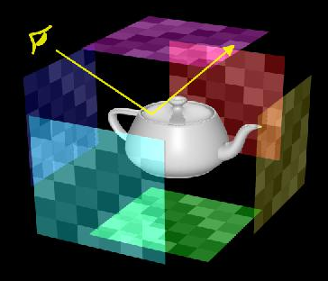
Environment/Reflection Mapping
This is an efficient image-based lighting technique for approximating the appearance of a reflective surface by means of a pre-computed texture image
6 texture images are needed for the 6 sides of the cube
For each vertex on the object, the vector from the viewing position to the vertex in the object is "reflected" about the
the normal at the vertex, giving a direction which is used to give the point a 2D texture coordinate

Slide 11
Calculating the Reflection Vector
In perfect reflection R and L have the same length, so R – (-L) = 2 * ( L . N ) N
=> R= -L + 2 * (L . N) N
(dot product L.N is the length of L projected onto N
N
light
source
N
R
L
R
L
surface
-L

Slide 12
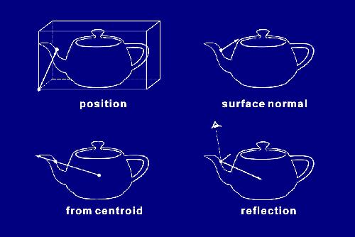
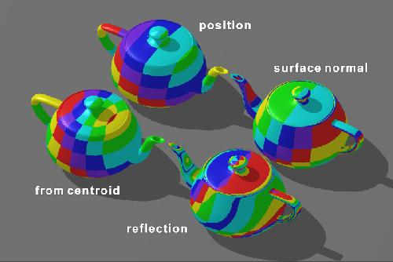
Texture Mapping
So we find a texture coordinate (s, t) for (x,y,z) associated with a point on the object. This (x,y,z) can be
Position coordinate of the point on the object, or
Surface normal at the point, or
Reflection vector at the point, or
Vector running from the object’s centroid through the point.

Slide 13
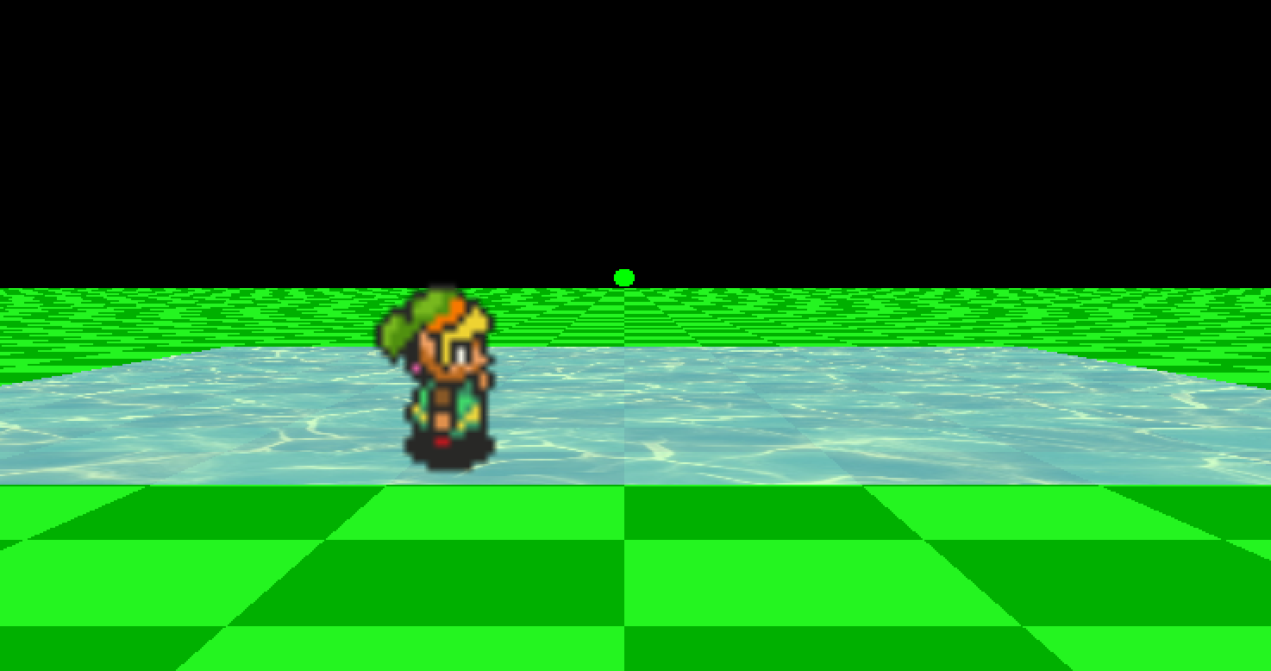
Texture Animation

Slide 14
Water Texture Animation
In the texture animation demo, the grid area for water animation is represented by a 2D array of size
xGridDims * zGridDims
(xGridDims+1) * j takes us to jth row
i + (xGridDims+1) * j takes us to the ith element on jth row
Z
xGridDims
zGridDims
j,i
X

Slide 15

Binding Texture Image and Texture Unit
Bind the texture image to texture unit. Each pair of s, t values (in [0, 1]) in texCoords[] index into the water texture image
texId = Scene::GetTexture(filepath);
glBindTexture(GL_TEXTURE_2D, texId);
Z
xGridDims
(0,1)
(1,1)
zGridDims
(0,0)
(1,0)
X

Slide 16

Assigning Texture Coordinates to Polygon
Locating Texel/Image Pixel using Texture Coordinate
t
(0,1)
(1,1)
(s,t)
(0,300) <= (0,1)
(300, 300) <= (1,1)
index into
(0,0)
(1,0)
s
z
assigned to
(0,1)
(1,1)
(0,0) <= (0,0)
(300, 0) <= (1,0)
zGridDims
Texcoord[] is an 1D array of length 2 * xGridDim * zGridDim
(0,0)
(1,0)
xGridDims
x

Slide 17
Assigning Texture Coordinates to Grid Cells
Texture coordinates are stored in a 1D array texCoords[] of length
2 * xGridDims * zGridDims
Each grid cell is assigned a texture coordinate (two values s, t in array texCoords[]:
0th grid cell is assigned to texCoords[0] and texCoords[1],
1st grid cell to texCoords[2] and texCoords[3],
…
i^{th} grid cell is assigned to texCoords[2i] and texCoords[2i+1]
Z
xGridDims
(0,1)
(1,1)
zGridDims
j,i
(0,0)
(1,0)
X

Slide 18
Changing Texture Coordinates / Animation
So the grid cells get the textures from the water texture image through the texture coordinates assigned to them (s, t values in texCoords[]).
Grid cell – texture coordinate – texel/image pixel
Changing the pairs of s, t values in texCoords[] in a circular fashion (trigonometry) for them to index into different (neighbouring) positions in the texture image, so the textures for the grid cells change, to give the illusion of water movement

Slide 19
Original Texture Coordinates
Original s values in texCoords[]:
texCoords[(i + (xGridDims+1) * j) * 2 + 0] =
i / xGridDims;
Original t values in texCoords[]:
texCoords[(i + (xGridDims+1) * j) * 2 + 1] =
j / zGridDims;

Slide 20
Changing Texture Coordinates
Changing s values in texCoords[]:
texCoords[(i + (xGridDims+1) * j) * 2 + 0] =
sin(time + j)) * radius + i / xGridDims;
Change t values in texCoords[]:
texCoords[(i + (xGridDims+1) * j) * 2 + 1] =
cos(time + i)) * radius + j / zGridDims;

Slide 21

Sprite Animation
Sprite based animation changes images in quick succession to give the illusion of movement
Sprites are small graphic elements of fixed width and height for implementing moving characters
A spritesheet is a structured single image, consisting of a series of animation frames laid out in a grid of Rows and Columns, but often with 1 row and many columns

Slide 22
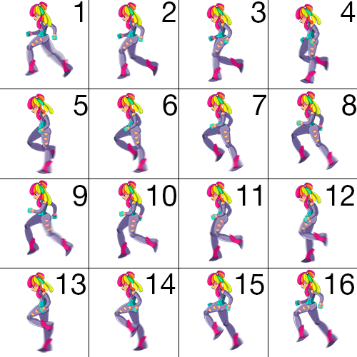
Spritesheet Animation
To animate spritesheet using texture mapping we consider each sprite image as a texture image
We have a polygon / quad that moves with time and we texture the polygon with a different texture / sprite image at a time

Slide 23
Assigning Texture Coordinates to Polygon
Locating Texel/Image Pixel using Texture Coordinate
texCoords[0], texCoords[1]
SpriteFrame=0
(
SpriteFrame=1
SpriteFrame=2
SpriteFrame=3
SpriteFrame=4
SpriteFrame=5
SpriteFrame=6
SpriteFrame=7
SpriteFrame=8
texCoords[2], texCoords[3]
index into
texCoords[4], texCoords[5]
texCoords[6], texCoords[7]
y
sCoord = float(spriteFrame) /
float(spriteWidth);
texCoords[0] = sCoord;
sCoord = float(spriteFrame+1) /
float(spriteWidth);
texCoords[4] = sCoord;
x

Slide 24
First we assign a texture coordinate to each of the 4 corner points of the polygon/quad. In the texture demo (link.cpp) program, texture coordinates in texCoords[] are assigned to the polygon as follows:
// Texture coordinate assigned to the top left of polygon glTexCoord2d(texCoords[0], texCoords[1]);
glVertex3f(-width/2.0, height, 0.0);
// Texture coordinate assigned to the bottom left of polygon
glTexCoord2d(texCoords[2], texCoords[3]);
glVertex3f(-width/2.0, 0.0, 0.0);
// Texture coordinate assigned to the bottom right of polygon
glTexCoord2d(texCoords[4], texCoords[5]);
glVertex3f( width/2.0, 0.0, 0.0);
// Texture coordinate assigned to the top right polygon
glTexCoord2d(texCoords[6], texCoords[7]);
glVertex3f( width/2.0, height, 0.0);

Slide 25
To produce forward (x direction) sprite movement we update the values in texCoords[] to index into the current sprite texture image: spriteFrame = 0; spriteWidth = 16;
// texture coord. indexes into top left corner of sprite
sCoord = float(spriteFrame)/float(spriteWidth);
texCoords[0] = sCoord; texCoords[1] = 1.0;
// texture coord. indexes into bottom left corner of sprite
texCoords[2] = sCoord; texCoords[3] = 0.0;
// texture coord. indexes into bottom right corner of sprite
sCoord = float(spriteFrame+1)/float(spriteWidth);
texCoords[4] = sCoord; texCoords[5] = 0.0;
// texture coord. indexes into top right corner of sprite
texCoords[6] = sCoord; texCoords[7] = 1.0;

Slide 26
To produce backward (-x direction) sprite movement we update the values in texCoords[] to index into the current sprite image:
// texture coordinate indexes into top left of sprite
sCoord = float(spriteFrame+1)/float(spriteWidth);
texCoords[0] = sCoord;
texCoords[1] = 1.0;
// texture coordinate indexes into bottom left of sprite
texCoords[2] = sCoord;
texCoords[3] = 0.0;
// texture coordinate indexes into bottom right of sprite
sCoord = float(spriteFrame)/float(spriteWidth);
texCoords[4] = sCoord;
texCoords[5] = 0.0;
// texture coordinate indexes into top right of sprite
texCoords[6] = sCoord;
texCoords[7] = 1.0;

Slide 27
Add a Texture Image to Project
With Windows: simply drop the file into your folder
With Mac:
Select you’re a project folder and select Add files to ..
In the file navigator locate the texture image you wish to use
In the tab that opens click ‘Build Phases’
Under Copy Files
Change the Destination to, e.g., Resources
Remove all the text in Subpath
Untick the box titled ‘Copy only when installing’
Click the small '+' button in the Copy Files section, in the tab that opens find the image inside the project files, select it and click add

Slide 28
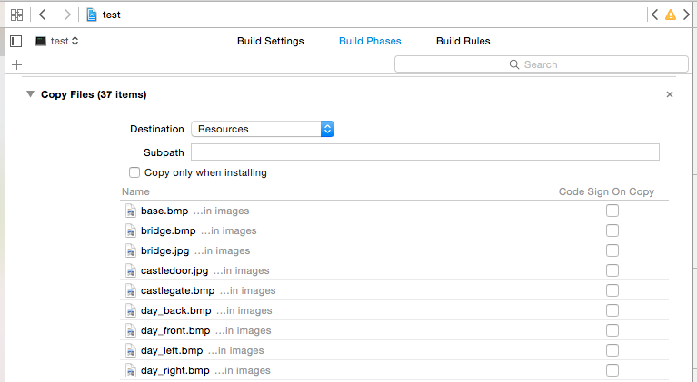
Add a Texture Image to Project

